Slide 1
An early attempt at Expressing SIMF Language (DSL) Proposals in the Montages abstraction of EMF and OCL (MCore), with Generated Editors for Specifying SIMF Models in n-level Meta Trees
12/8/2012
zenie@montages.com

Slide 2
Mapping Proposed SIMF DSLs to MCore
Currently Proposed SIMF DSLs (being merged in ongoing design meetings and discussions)
Concept Spaces, Towards a Unified Semantic Model, 10 October 2012
SIMF 2012vMetamodel, Logical Foundation: Context, Types, and Assertions
First Increment of the EU SIMF Conceptual Generic Model
Some new EMF abstractions, implemented via work arounds or specializations, are required:
Relationships: EMF has a Structural Feature for References, they are not Classifiers, they are just features, like Attributes. In the SIMF 2012 Metamodel mapping to follow, where the references (UML Associations) have type and are specialized and generalized, UML Associations are expressed as Classes and their Association Ends as References, as a work around.
EMF is container hierarchy orientated in how it generates, may be other concerns. Hopefully MCore will cover much and where not consideration of further extension is required, we have found EMF is built to be extended.
Other SIMF items being considered
Multiple classification

Slide 3
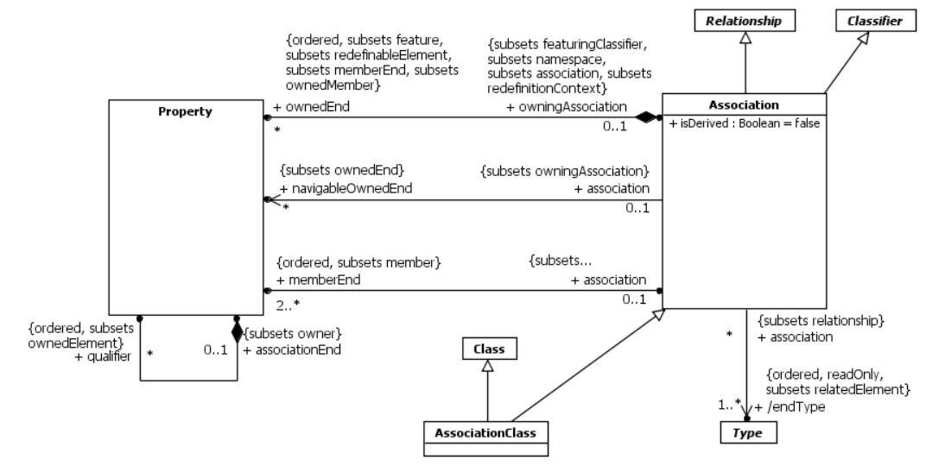
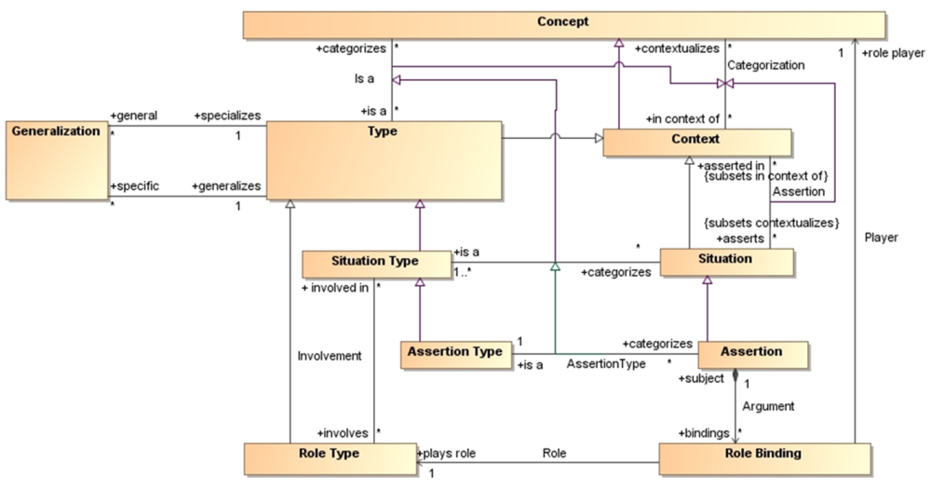
Relationships as First Class Elements (Classifiers) 1
Associations (as in UML Simplified), adding a classifier to ECore, fate of EReference tbd
To support examples such as:

Slide 4
Mapping Proposed SIMF DSLs to MCore, Other Requirements
Modeling Editors
Most SIMF modelers appear to prefer a graphical interface (like UML’s) when modeling; as well as Property tables, etc..
I expect there may be a requirement for a MCore graphical interface generated as:
SIMF may have long meta trees, graphics + may be required
At these levels of abstraction the modeler sees the world differently
Mappings and Transforms
Standard EMF supplied (UML, eMOF, XML Schema)
MCore2ECore Roundtrip supplied
New requirements not supported by EMF or MCore, such as OWL and RDF mappings, possible development or methodology required
Domain models with many meta levels require a new presentation design and require mappings from themselves and their generated editor instances back to MCore, to generate an instance editor of its model, to continue the tree..

Slide 5
Other Requirements 2
Instances and Types
The EMF UML to ECore Mapping is limited, has problems with UML Profiles and other issues
Assuming most of the mapping works, and is extendible, extending this will have general value (beyond SIMF)
Could be a workaround via XML Schema, tbd.
Validation completed
Others tbd

Slide 6
SIMF Proposed DSLs

Slide 7
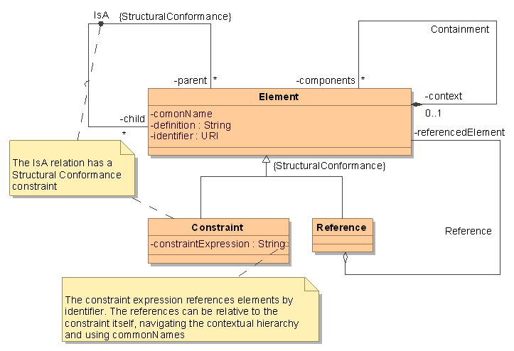
Concept Space Overview (copied from Concept Spaces, 10 October 2012, Figure 3-1)

Slide 8
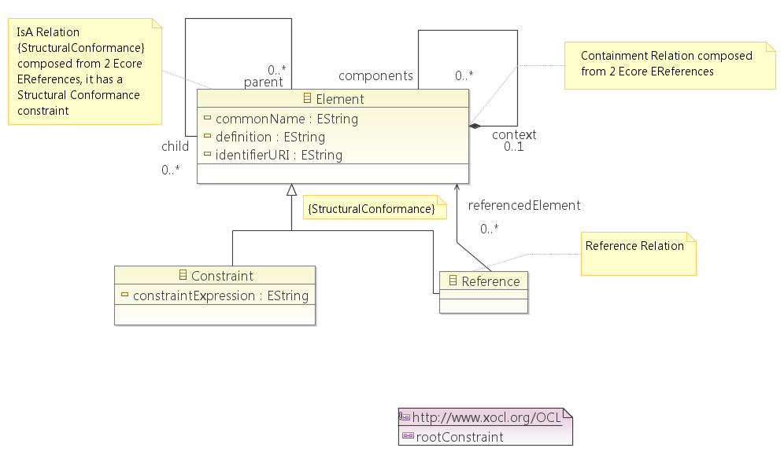
Concept Space SIMF DSL in ECore and XOCL

Slide 9
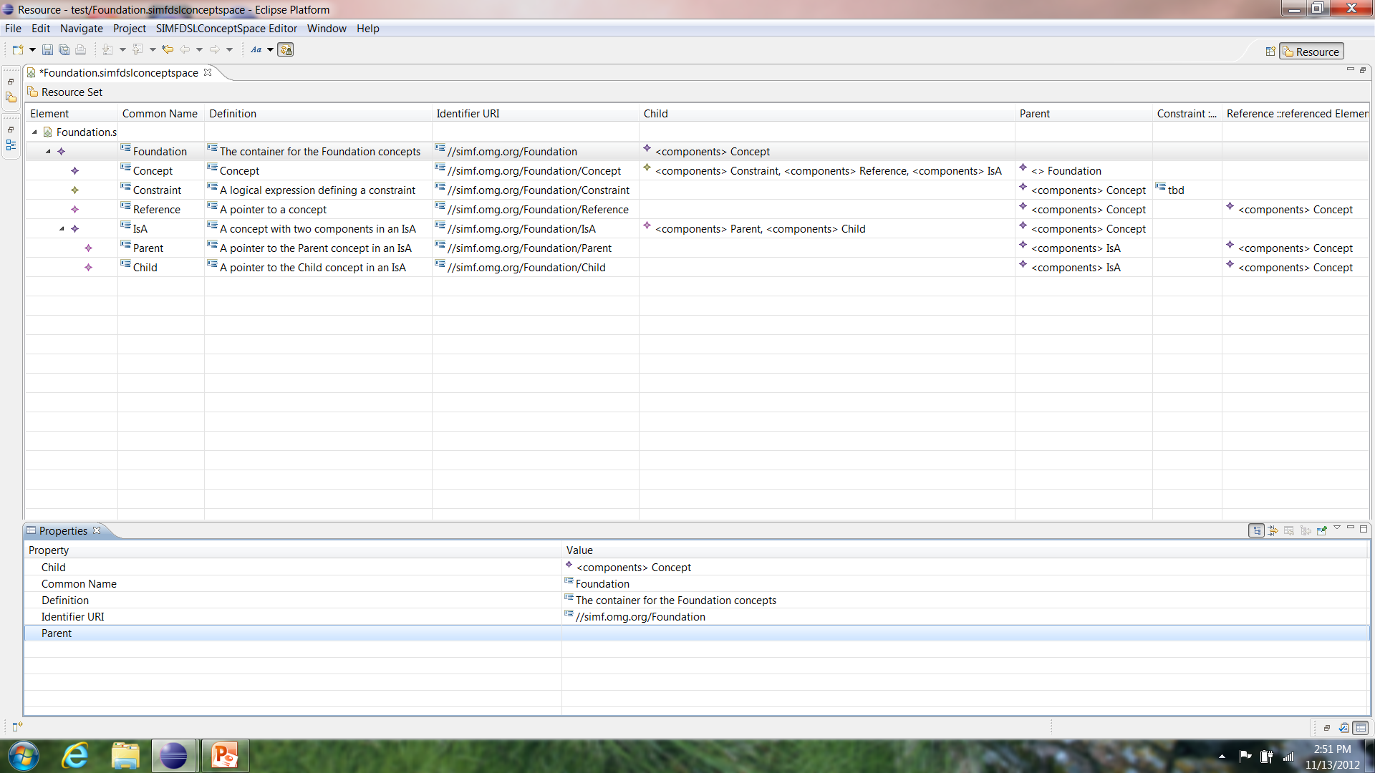
Generated Concept Space Editor with a Foundation Concept Space Specified

Slide 10
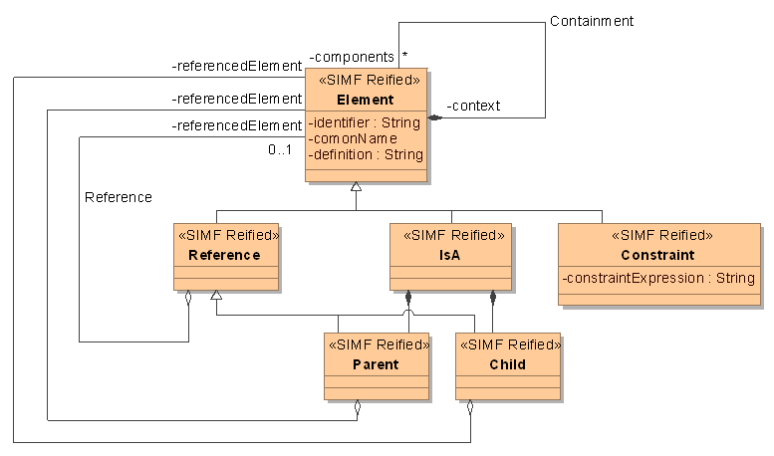
Concept Space with Reified IsA Relationship (copied from Concept Spaces, 10 October 2012, Figure 3-7)

Slide 11
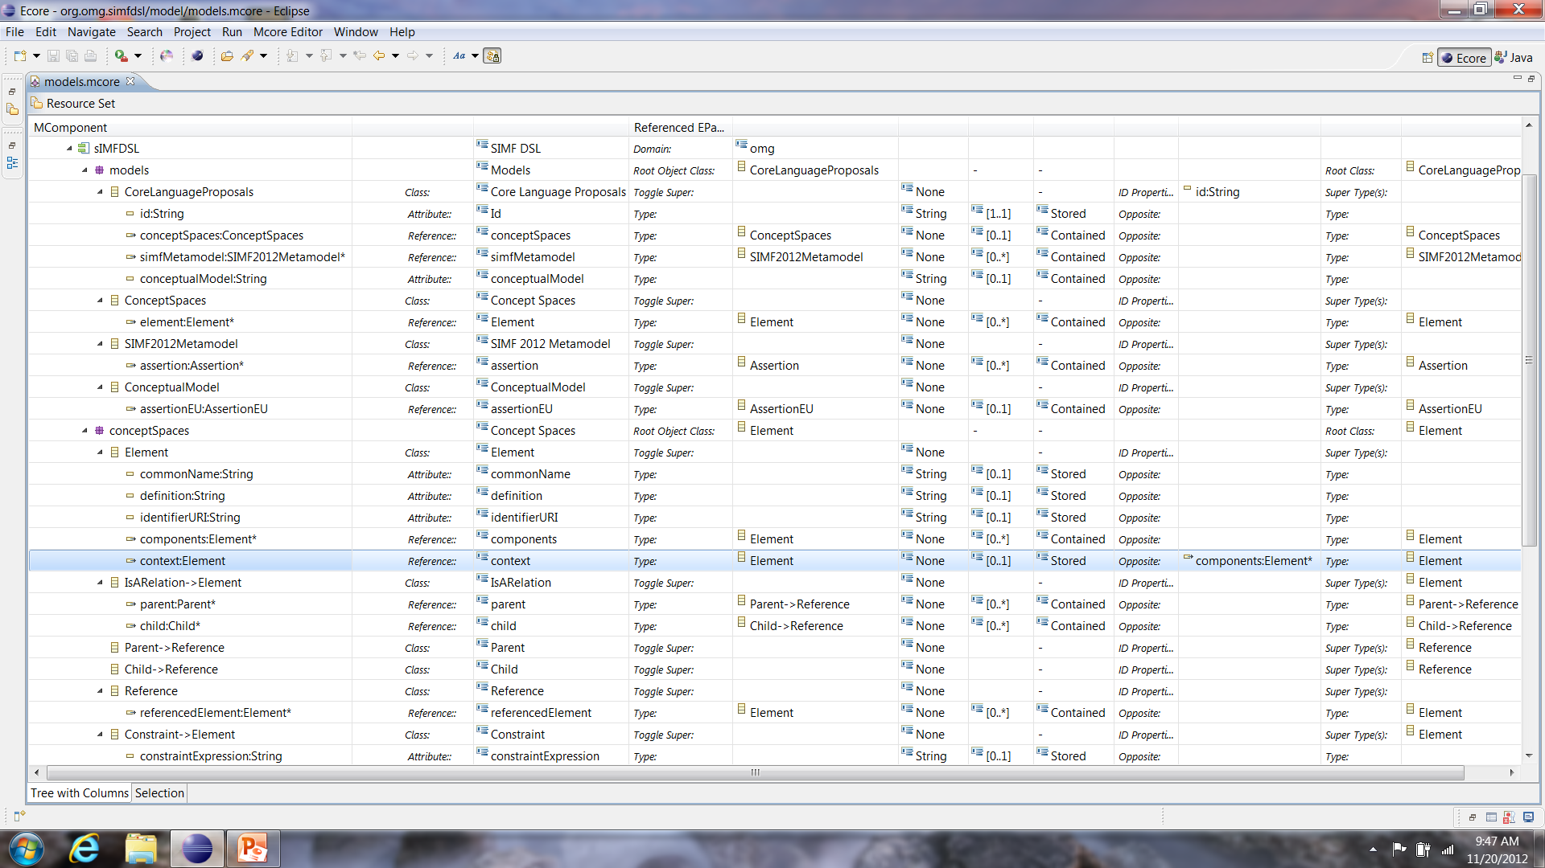
Concept Space Expressed in MCore with the IsA Relationship

Slide 12

SIMF Metamodel Logical Foundation: Context, Types & Assertions (copied from Model Driven Solutions SIMF Metamodel Introduction as of 4/5/2012)

Slide 13
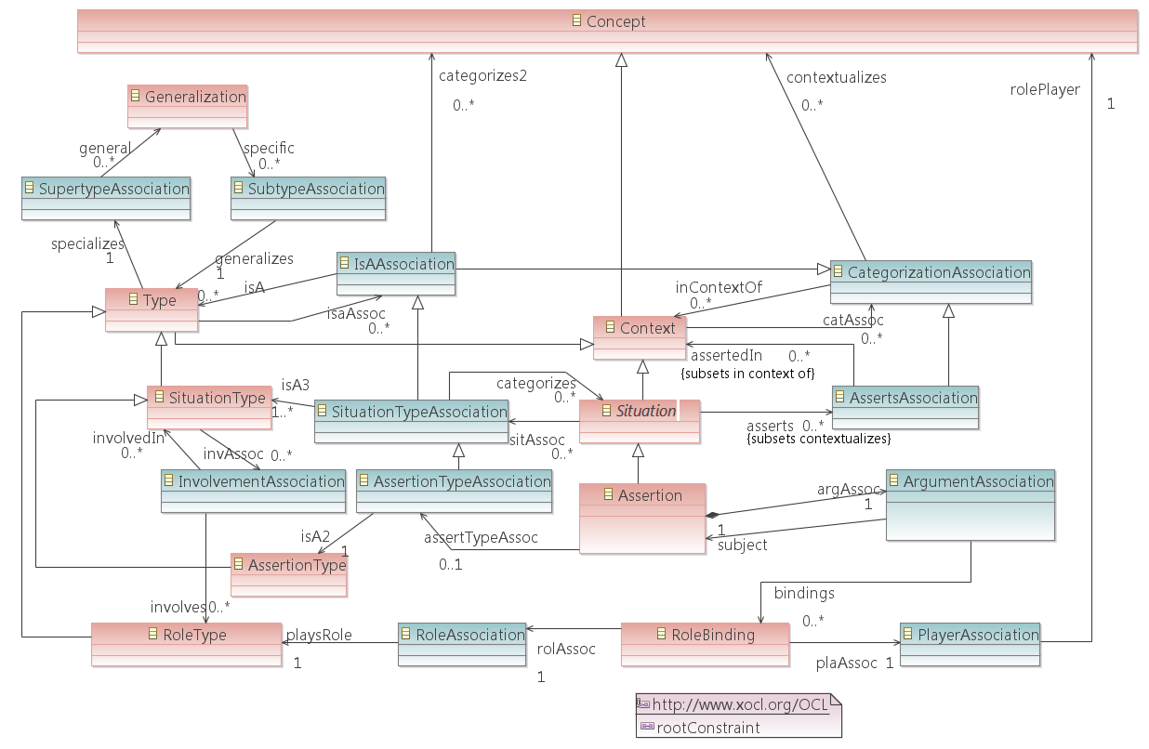
SIMF Logical Foundation DSL with Associations as Classifiers

Slide 14
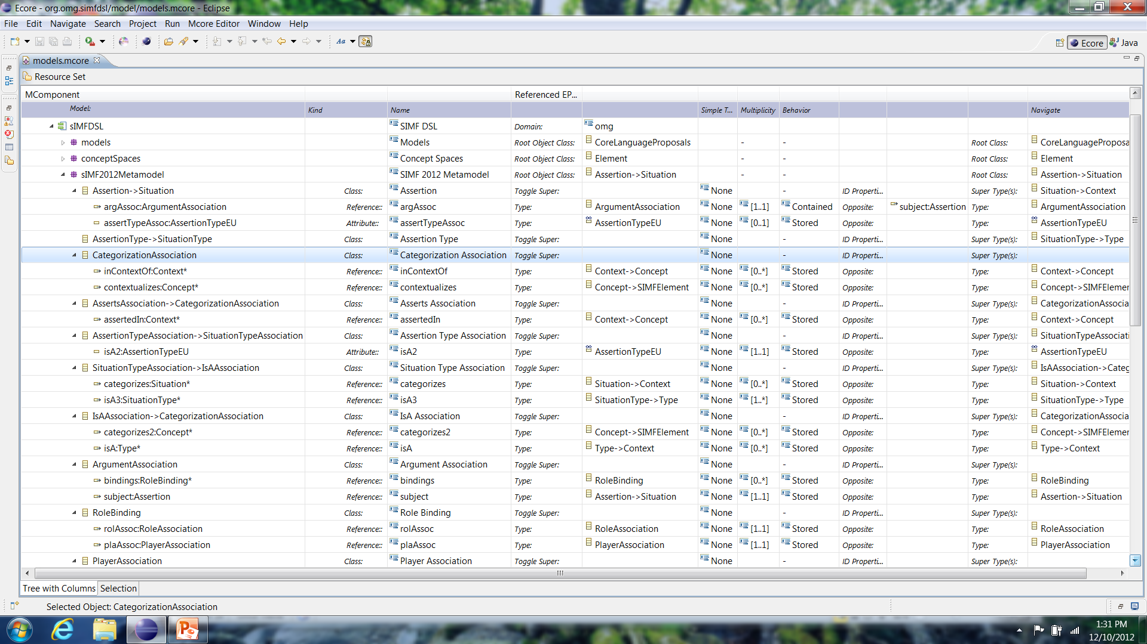
SIMF Metamodel Expressed in MCore(1)

Slide 15
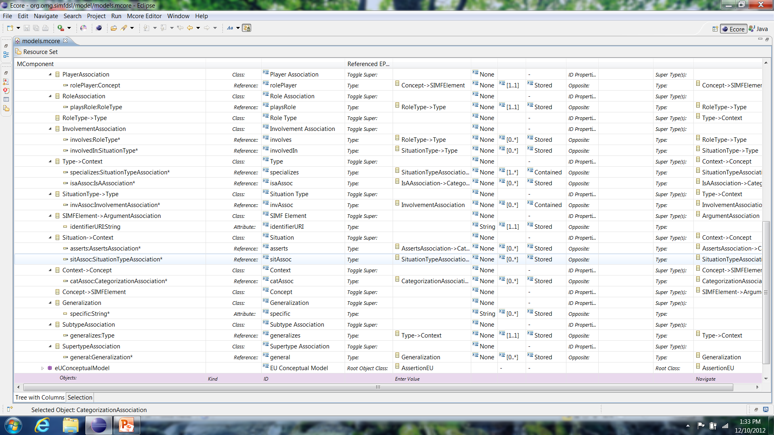
SIMF Metamodel Expressed in MCore(2)

Slide 16
To Do
SIMF Logical Foundation Editor
current mapping source is an informal concept model for discussion
to map to MCore and generate a useful editor a formal version of the SIMF DSL is required
Am able to generate an editor but it’s tree has only 1 branch so far
If a container hierarchy is required to generate, either the formal SIMF DSL will have this or, if not, do we need to extend the generation process?
EU SIMF Conceptual Generic Model
Metamodel derived from examples to map and generate a editor from

